Slide 1
Malware
Computer Security

Slide 2
What is malware?
Malware (malicious software)
Software designed to infiltrate, damage or disrupt a computer system without the owner's informed consent

Slide 3
Consequences of Malware?
Malware may often…
Steal your personal information
Monitor your computer activity
Install additional software
Display forced advertising
Enable profiteering scams
Use your computer resources (CPU, RAM etc.)

Slide 4
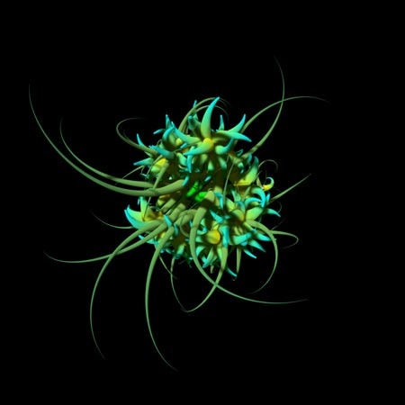
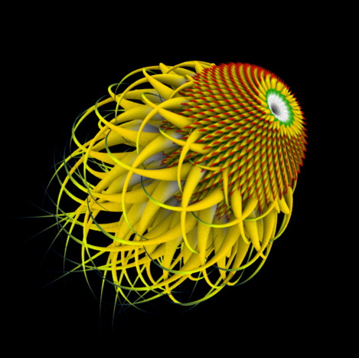
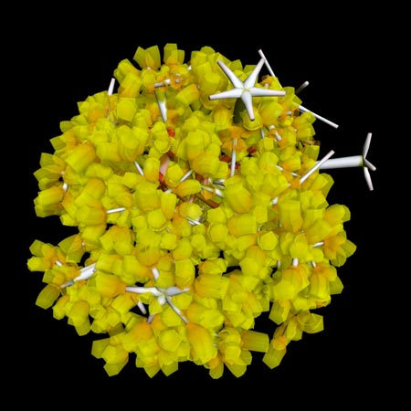
What malware looks like to an IT professional?
MyDoom
MSNthreat Trojan
IRCBot
“Malwarez is a series of visualization of worms, viruses, trojans and spyware code. For each piece of disassembled code, API calls, memory addresses and subroutines are tracked and analyzed. Their frequency, density and grouping are mapped to the inputs of an algorithm that grows a virtual 3D entity. The patterns and rhythms found in the data, influence the configuration of the artificial organism.” http://sq.ro/malwarez.htm

Slide 5
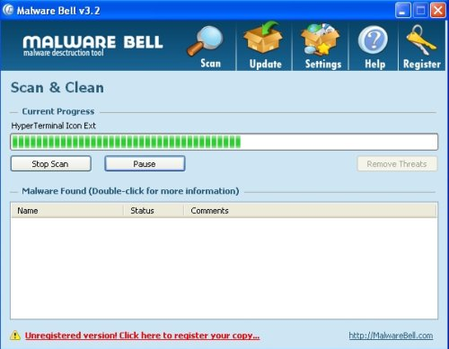
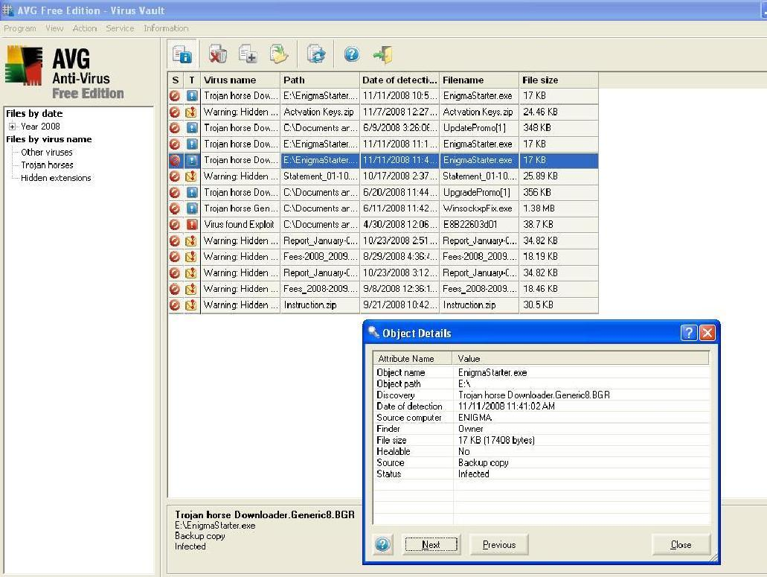
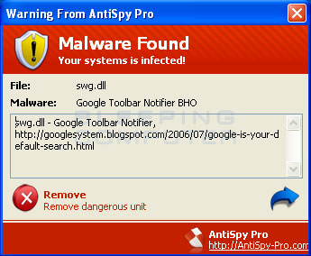
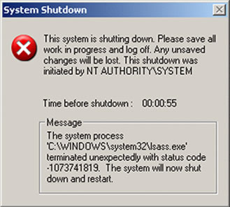
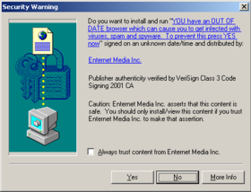
What malware looks like to a home user?

Slide 6
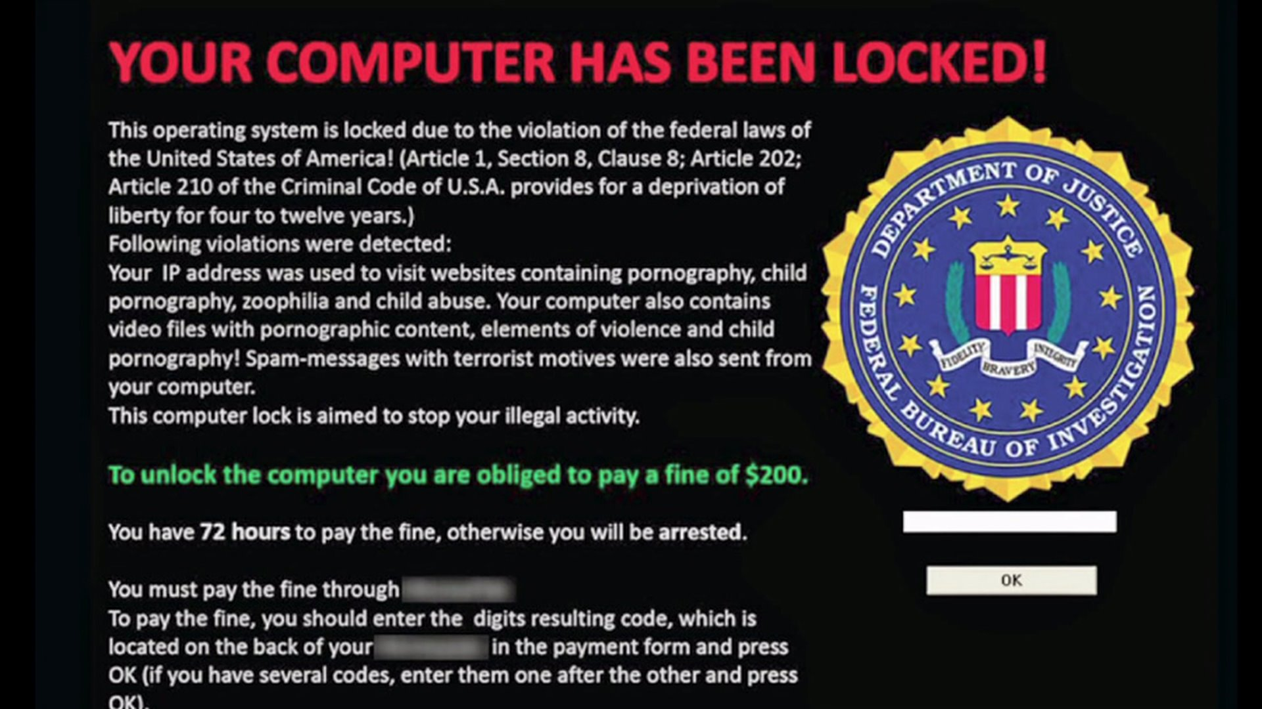
Scare tactics?

Slide 7
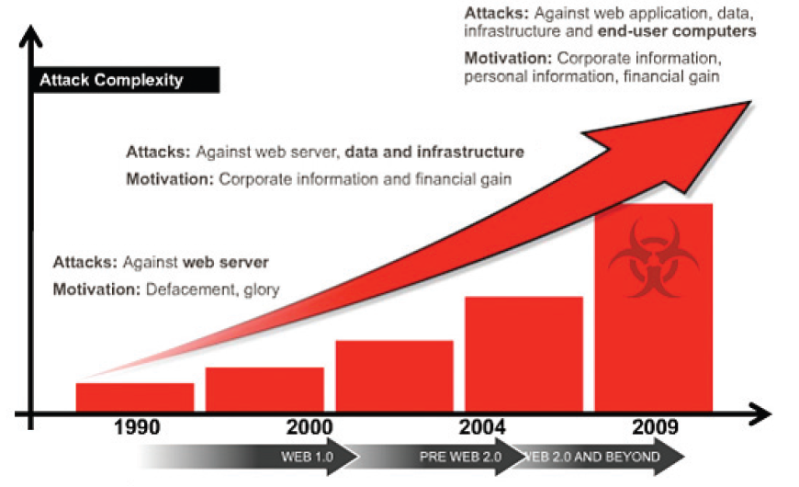
Evolution of malware
Source: http://www.malware-info.com

Slide 8
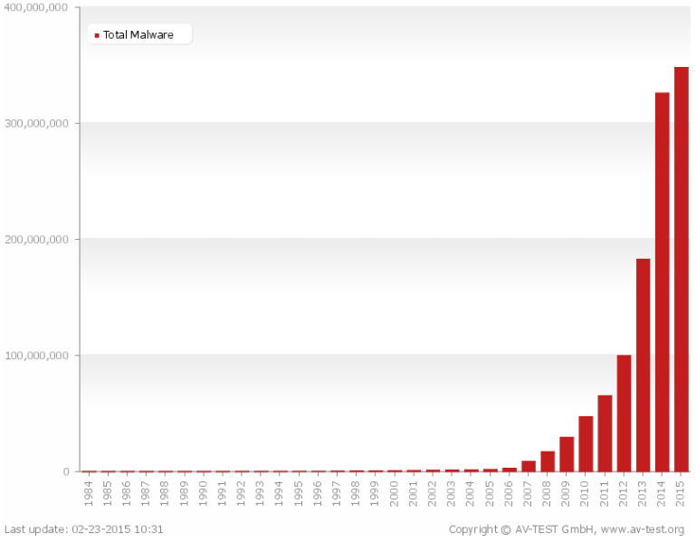
Total malware

Slide 9
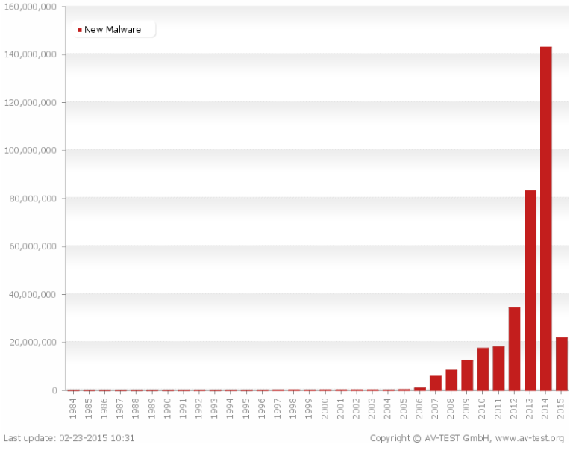
New malware

Slide 10
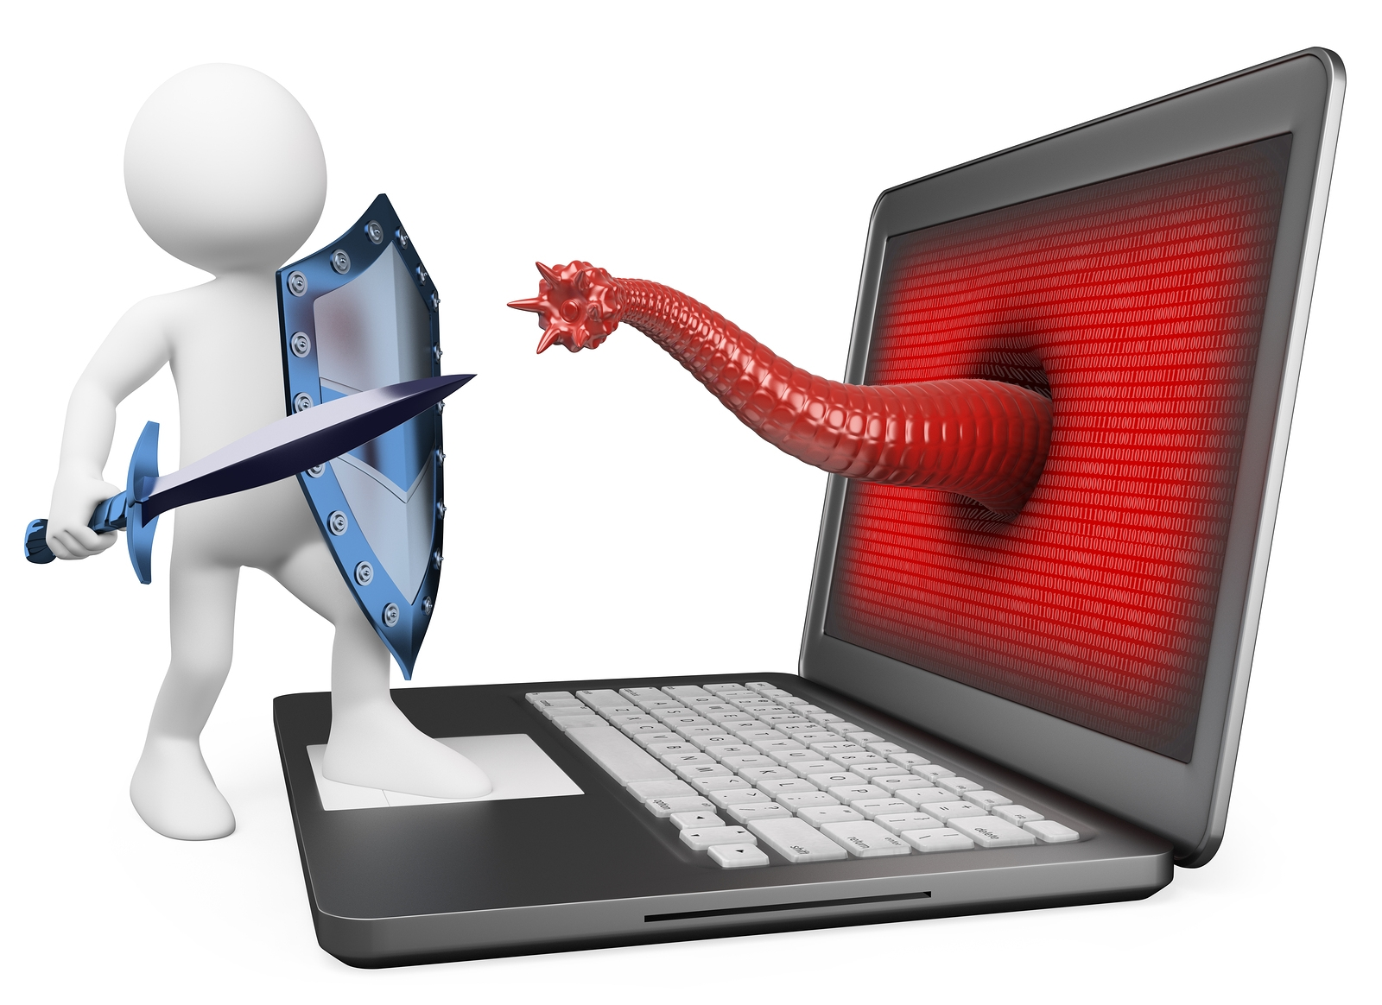
Malware Categories
Viruses
Trojan horses
Worms
Rootkit
Botnets
Logic bombs
Spyware
Scareware
Ransomware

Slide 11
When does a system becomes vulnerable to malware?
Flaws or bugs in software
Over privileged users or system processes
Design of software or a system
Poorly implemented Standard Operating Environment (SOE) practices

Slide 12
Malware Specimens
Zeus Trojan horse
Commonly spread by FaceBook messages
Installed via drive-by-downloads and phishing
Works on Microsoft Windows only
Attacker fine tunes their Trojan to steal information of interest to them only
Awakes when a particular site is accessed

Slide 13
Malware Specimens
Psyb0t
Targets Linux based ADSL routers
Infection occurs from an internal IP address
Initially pre-populated with 6000 usernames and 13,000 passwords
Generally exploits poorly configured devices
When part of a botnet is receives commands via IRC command and control servers

Slide 14
Classifying malware
Malware can be classified into several categories, depending on the propagation, concealment and payload
Propagation e.g.
Human-assisted (i.e. virus in email attachment)
Automatic propagation (i.e. without human assistance…a worm)

Slide 15
Classifying malware
Concealment e.g.
Modifies OS to hide its existence (rootkit)
Provides desirable functionality (Trojan)
Payload
Amusing/annoying pranks
Destroy or corrupt files
Denial of Service attacks
Install backdoor(s)
Alter web browser settings to display advertising

Slide 16
Viruses
A computer virus is a piece of software (code) that can infect other programs by modifying them
A virus attaches itself to another program and secretly executes when the host program is executed
A virus will require user assistance
Opening an email attachment
Sharing a USB drive

Slide 17
Virus phases
Dormant – waiting on a trigger event
Propagation – replicating to programs/disk
Triggering – by event to execute payload
Execution – of payload

Slide 18
Virus phases cont…
Dormant phase: The virus is idle. The virus will eventually be activated by some event, such as a specific date, the presence of another program or file.
Propagation phase: The virus places an identical copy of itself into other programs or into certain system areas on the disk. Each infected program will now contain a clone of the virus, which will itself enter a propagation phase.

Slide 19
Virus phases cont…
Triggering phase: The virus is activated to perform the function for which it was intended.
Execution phase: The function of the virus is performed. This may be harmless, e.g. a message on the screen, or damaging, e.g. the destruction of programs and data files

Slide 20
Virus structure
Typically consist of three logical components
Infection/replication mechanism
Trigger – what will trigger the payload?
Payload – a malicious or benign outcome
Not all viruses have an active payload, some simply replicate for the sake of replicating

Slide 21
Virus types
File virus
Infecting a highly used program i.e. a game or operating system files will result in continuous re-infection and propagation
Macro virus (macro language)
Infects files with macro code
Commonly infects MS Office documents
Boot sector virus
Infects the code in the boot sector of hard disk

Slide 22
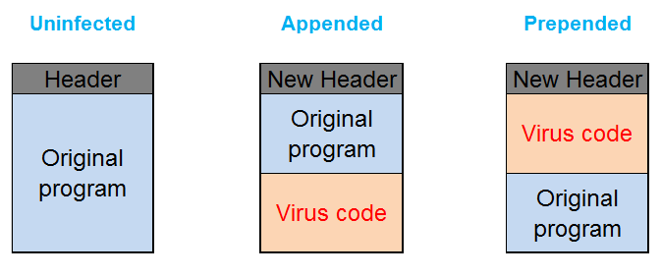
Common file virus injection techniques
Adapted from SANS Malware 101
Notes:
Adapted from SANS Malware 101.
Appended Virus – The virus attaches itself to the end of the host file and modifies the header of the host file so that the control shifts to it on execution. In an appending virus infection, the virus code is appended to the host program and the main entry point of the host program present in the program header is changed to point to the beginning of the virus code. So, when the program executes, the virus is executed first. Then at the end of the virus code, a jump or call routine takes the control back to the start of the host program. Also the new size of the infected host file is updated in the header accordingly.
Prepended Virus – This is a type of virus that attaches itself to the start of the executable before the host file content. In a prepending virus infection, the virus code is inserted in the starting of the program immediately after the header. So, when the program executes, the virus is executed first. Then the control reaches the end of the virus code and passes down into the host program code to execute the host program. The new size of the host file size is updated in the header accordingly.
Overwriting Virus – This is a type of virus that completely overwrites the entire host file that it attacks. The host file is lost and completely modified by the virus to add its code. In an overwriting virus infection, the virus code is overwritten over a portion or entire host program code. If the host file is larger than the virus program, the virus can either remove the whole host program code and replace it with a copy of its own code or overwrite the program code with its own code starting at the initial program code entry. So, when the host program is executed, the control is passed to the starting of the program code (that is overwritten by the virus code) and the virus gets executed. After the execution, the control passes to the remains of the host program code that will not make any sense as the initial part of the code is missing and the host program crashes. If the virus replaces the whole of the host program data segment and is larger than host program, the header needs to be modified to reflect the new size. If the virus replaces portion of the host program data segment, there will not be any change in the program size. These are the smallest (just a few bytes) and are mostly destructive.

Slide 23
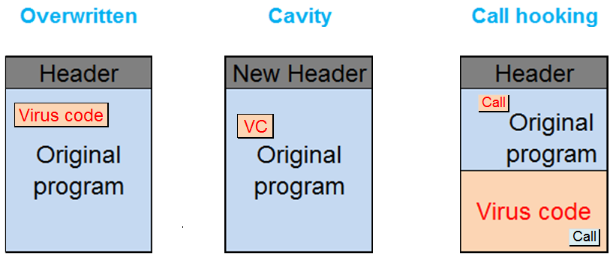
Common file virus injection techniques
Adapted from SANS Malware 101
Notes:
Adapted from SANS Malware 101.
Overwriting Virus – This type of virus completely overwrites the entire host file that it attacks. The host file is lost and completely modified by the virus to add its code. Once execution of the virus is complete the original program will not execute correct as essential code elements will no longer be present.
Cavity Virus – In a cavity virus infection, the virus copies itself to one of the cavities present in the executable.The header of the original program is modified and control is passed directly to the virus. The file size remains unchanged as the virus occupies empty space in the code.
Call hooking or Entry Point Obfuscation virus – This type of virus changes a random location in the host file data instead of the changing the headers or the initial host file data, so that the entry point of the virus is hidden in the host file safely.

Slide 24
Virus concealment strategies
Encrypted virus
Payload and replication mechanism is encrypted
Virus = decryption engine + encrypted body
Encryption remains the same throughout the life of the virus
Stealth virus
Hides itself from AV detection
May copy data from non-infected files to itself to avoid detection

Slide 25
Virus concealment strategies
Polymorphic virus (change appearance of)
Mutates with every infection
Changing encryption/decryption keys
Data appending / data pre-pending
Metamorphic virus
Mutates and rewrites itself with every iteration
Adding useless instructions and loops

Slide 26
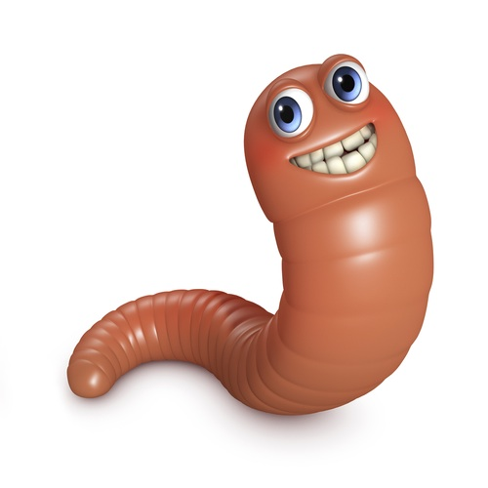
Worms
A computer worm is a program that spreads without needing to insert itself into other files and usually without human interaction
A worm will encompass a malicious payload such as; deleting files or creating a backdoor
Most worms spread by exploiting vulnerabilities or poorly configured systems

Slide 27
Worm Propagation
Scan for targets on network
Locate a target with a vulnerability that could be exploited by the worm
Exploit the identified vulnerability and establishes itself on that host
Repeats the process by scanning for new targets that can be exploited

Slide 28
Worm Types
Internet worms – scans system for exploit
Instant messaging – use contact lists to spread infected links
IRC worms – spread in channels by sending infected links or files to other IRC users
File-sharing network worms – are located in shared folders and spread to connected hosts

Slide 29
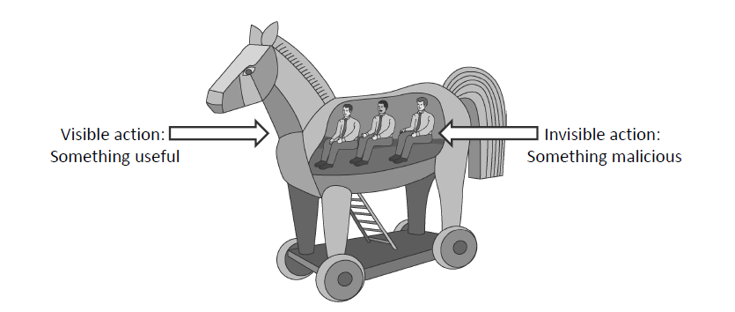
Trojan Horses
A Trojan horse (or Trojan) is a program that appears to perform a useful task, but also performs a negative task
Can be a resultant payload or its own program

Slide 30
Trojan Horse Types
Simple / ‘classic’ Trojan horse
A calculator program that looks and acts as a calculator, but every time the 7 button is pressed it deletes a random file from the hard drive
Remote access Trojan horse
A backdoor into a system and allow an attacker to execute or monitor actions on the victim’s computer
Indirect Trojan horse
Use infected computer to launch attacks

Slide 31
Rootkits
A stealthy application designed to hide the fact that an operating system has been compromised.
Typically encompass three components
Concealment
Command and control
Surveillance

Slide 32
Types of Rootkits
User-mode rootkits
Run on infected device with admin/root access
May alter/hide security settings, process, files, system drives, network ports and system services
Can typically be removed with AV software but (some) damage to the system may be unrepairable

Slide 33
Types of Rootkits
Kernel-mode rootkits
Kernel-mode rootkits run at the operating system level by adding to or changing critical system files
Modify kernel data structures to return manipulated information to user applications
System is infected via updates/patches
Removing kernel-mode rootkits is extremely problematic

Slide 34
Types of Rootkits
Firmware rootkits
Hides in firmware stored on flash memory
Restarting/power cycling the infected device will result in a re-contamination
Removal of a firmware rootkit is temporary until the infected device is restarted
May require an entire firmware update to be loaded resulting in data/settings have been lost

Slide 35
Botnets
Botnet (or robot network) is a collection of compromised computers
Each compromised computer has software (malware) installed
The ‘master’ controls each of the computers (zombies) over the Internet via the installed malware

Slide 36



Botnets
Malware can turn a host into a zombie
A zombie is a machine controlled by a master
Botnet Controller (Attacker)
Attack Commands
Botnet:
Attack Actions
Victim

Slide 37
Botnet Trends
Criminals are selling/buying botnets for personal use
Sending spam/phishing email
Launching Denial of Service attacks
Breaking crypto
Launching additional malware
Investigations suggest that approximately 80% of spam originates from compromised home computers

Slide 38
Logic Bombs
A logic bomb (usually) performs a malicious action as a result of a certain logic condition
A programmer puts code into software for the payroll system that makes the program crash should it ever process two consecutive payrolls without paying him ☺
Some trial programs work for a certain period of time and then disable themselves

Slide 39
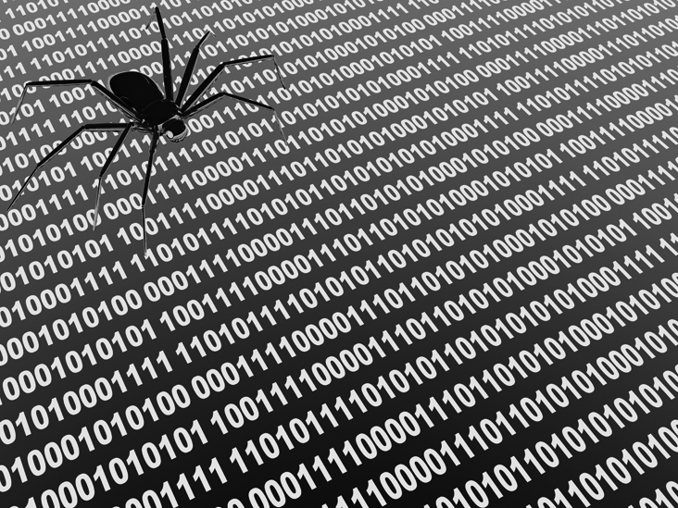

Spyware
1. Spyware infects
a computer
2. Spyware process collects
keystrokes, passwords,
and screen captures.
3. Spyware process
periodically sends
collected data to
spyware data collection
agent.

Slide 40

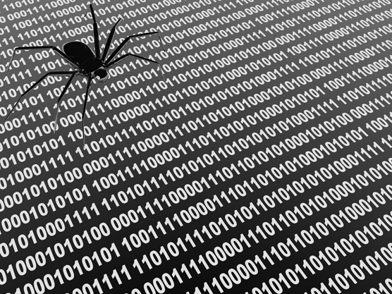

Adware
Adware infects
a computer
Adware engine requests
Ads from
adware agent
Advertisers contract with
adware agent for content
Adware agent delivers
ad content to user
Adware agent
Advertisers

Slide 41
RansomWare, ScareWare
RansomeWare
Software that ‘kidnaps’ a user’s computer by encrypting a drive or files, then demanding payment to decrypt it
ScareWare
Prompts tricking the user into download malicious software
Also known as fake anti-virus software

Slide 42
Professional Malware
Growth in professional cybercrime and online fraud has led to demand in professionally developed cybercrime
New malware is often custom designed to the suit the needs/requirements of customer

Slide 43
Malware Countermeasures - Signatures
Each malware specimen has a unique set of instructions
Instructions form the signature or ‘fingerprint’
Anti-virus software uses a signature database to detect known malware
A file is considered infected if it contains the known signature or unique instructions

Slide 44
Malware Countermeasures - Signatures
Sometimes false positives occur…
A ‘safe’ file has instructions similar to a known virus file
The vendors signature database is proprietary
Demand for vendors detecting and releasing an updated database of signatures is high
Until your anti-virus software database is updated you remain vulnerable

Slide 45
Shield vs. On-demand
Shield
Background process (daemon/service)
Scans when a file is touched (open, copy, etc.)
On-demand
Scan on explicit user request or according to regular schedule
Scan on a suspicious file, directory, drive, etc.

Slide 46
Online Anti-Virus Software
Free browser plug-in
No shielding
Software/signatures updated before scan
Each scan requires internet connectivity
Report collected by company that offers SW

Slide 47
Offline Anti-Virus Software
Installed on the operating system
System shielding
User configurable
Scan without an Internet connection
Requires explicit user updates
Paid or free annual subscription

Slide 48
Quarantine
Suspicious files can be placed into quarantine
This is beneficial when you suspect a file, but are waiting for signature updates
Whilst the file is in quarantine it is harmless because it is encrypted
Details of quarantine methods are proprietary and hence kept secret

Slide 49
Fake AV Software
Fake AV software
2010-2011 fake AV software tricked users into installing malicious software
Damage to system was quickly apparent
2012 fake AV still tricking users
Damage not apparent
Software portrays itself as being beneficial
Shows continues virus removal
Fake AV expires and requests payment for its use

Slide 50
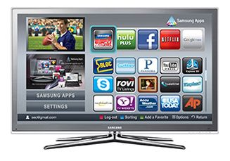
Future of Malware
What will malware look like in the future?
Mobile phones, ADSL routers, GPS?
Malware in embedded systems?
Smart televisions
Any electronic device could be infected with malware
Implications for hospitals?
How about planes?

Slide 51
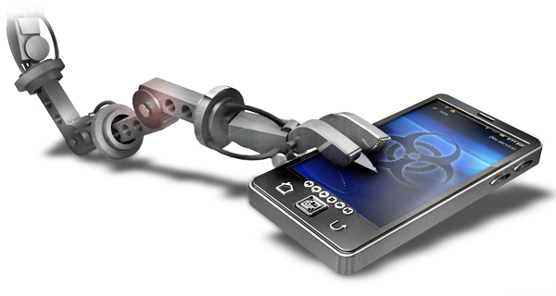
Mobile malware
Smart phone banking on the increase
Smart phones/tables replacing traditional computers…
Smart phones for two-factor authentication

Slide 52
Future of Malware
Cyber warfare
It is easier to hire a dozen hackers than it is buy a dozen missiles!
Will malware be the form of terrorism in the future?
Robbing a bank with gun lacks class
Why not just use malware?

